Slide 1

Environmental crisis
Morning sharing s.6 English group B
6e benny choy
6e amreen kiran
6a tinny chan
6d peter lo

Slide 2

The change of North Pole for the last decades.
The current total area of ​​the Arctic is 21 million square kilometers, of which 8 million square kilometers of land

Slide 3
Basic Habitat
Polar bears live in countries that ring the Arctic Circle: Canada, Russia, the United States (in Alaska), Greenland and Norway.
Basic Food source
Polar bears eat harp and hooded seals and scavenge on carcasses of beluga whales, walruses, narwhals, and bowhead whales.

Slide 4
The future of the polar bears
Much of the region is facing significant ice loss in the coming decades - with potentially serious consequences for polar bears.
Global polar bear numbers are projected to decline by 30% by 2050.
https://www.youtube.com/watch?v=TAN4RCOaqeE

Slide 5
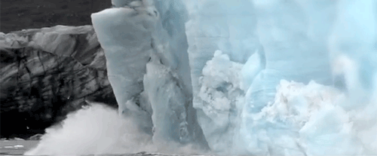
The information of ice melt
Since the early 1900s, many glaciers around the world have been rapidly melting. Human activities are at the root of this phenomenon. Specifically, since the industrial revolution, carbon dioxide and other greenhouse gas emissions have raised temperatures, even higher in the poles, and as a result, glaciers are rapidly melting, calving off into the sea and retreating on land.

Slide 6
Cause of Ice melt: global warming
oil and gas drilling
burning of fossil fuels
Deforestation
Excessive use of vehicles

Slide 7
ICE MELT:
https://www.youtube.com/watch?v=VbiRNT_gWUQ

Slide 8
The Maldives
It is the most popular tourist spot in the world
It’s likely to sink in 50 years, because the melting ice has led to the rise of water level

Slide 9
Solutions
Reduce the use of air-conditioner or electric devices
Take public transportation instead of private vehicles
Bring your own water bottle or shopping bags instead of using the plastic ones

Slide 10
Thank you for listening. Let’s save our planet together!

